Slide 1
Advanced Sorting
Lecture # 12

Slide 2
Review
sorting – the process of arranging a collection of items such that each item and its successor satisfy a prescribed relationship.
sort key – values on which items are ordered.
items arranged in ascending or descending order.

Slide 3
Sorting Algorithms
Can be divided into two categories:
comparison sorts
items are arranged by performing pairwise logical comparisons between two sort keys.
distribution sorts
distributes the sort keys into intermediate groups based on individual key values.

Slide 4
Merge Sort
Uses a divide and conquer strategy to sort the keys stored in a sequence.
Keys are recursively divided into smaller and smaller subsequences.
Subsequences are merged back together.

Slide 5
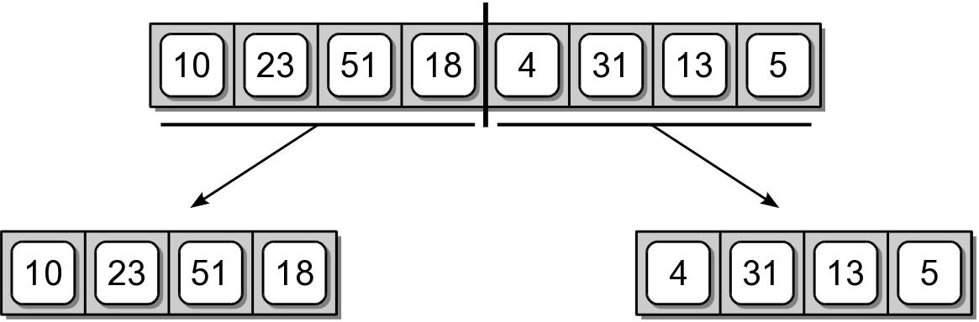
Merge Sort – Divide
Starts by splitting the original sequence in the middle to create two subsequences of approximately equal size.

Slide 6
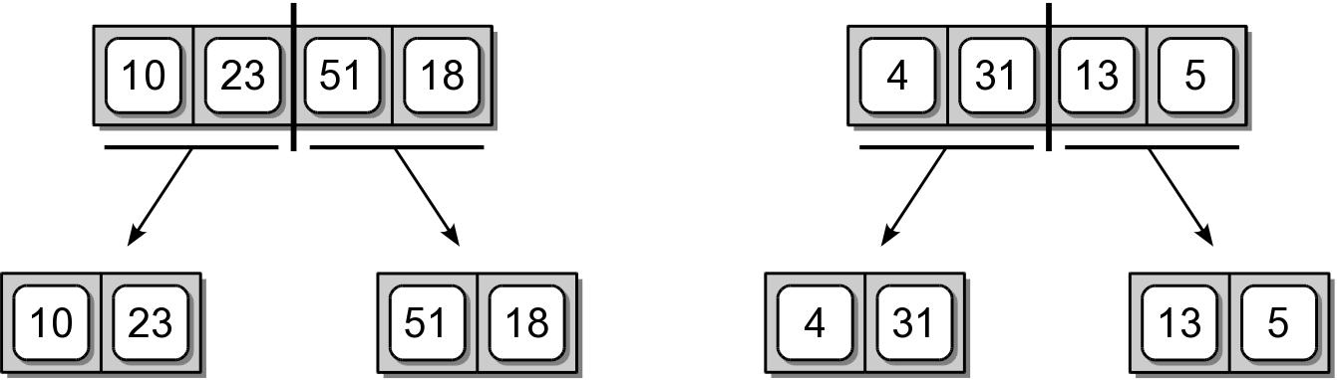
Merge Sort – Divide
The two subsequences are then split in the middle.

Slide 7
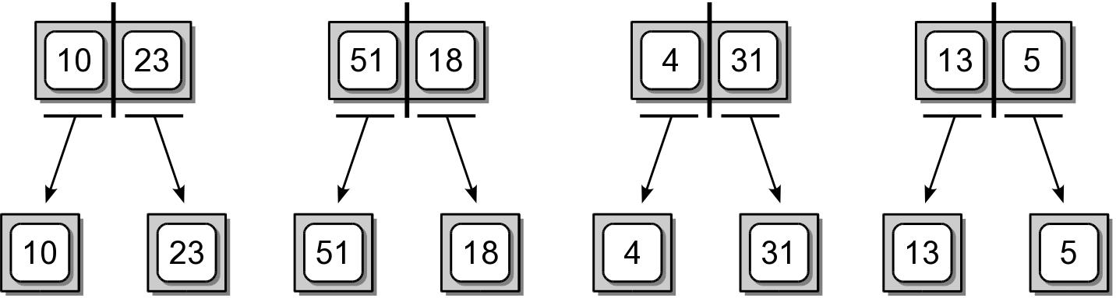
Merge Sort – Divide
The subdivision continues until there is a single item in the sequence.

Slide 8
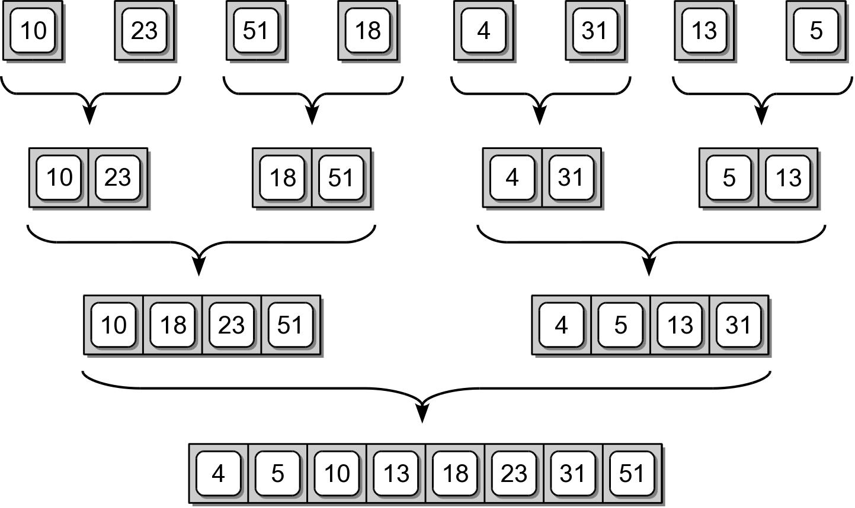
Merge Sort – Conquer
After the sequences are split, they are merge back together, two at a time to create sorted sequences.

Slide 9
Merge Sort Code #1
A simple implementation for sorting a Python list.
def pythonMergeSort( theList ):
# Check the base case.
if len(theList) <= 1 :
return theList
else :
# Compute the midpoint.
mid = len(theList) // 2
# Split the list and perform the recursive step.
leftHalf = pythonMergeSort( theList[ :mid ] )
rightHalf = pythonMergeSort( theList[ mid: ] )
#Merge the two ordered sublists.
newList = mergeOrderedLists( leftHalf, rightHalf )
return newList

Slide 10
Merge Sort – Improved Version
The previous version:
only works with Python lists.
the splitting creates new physical lists.
uses the splice operation which is time consuming.

Slide 11
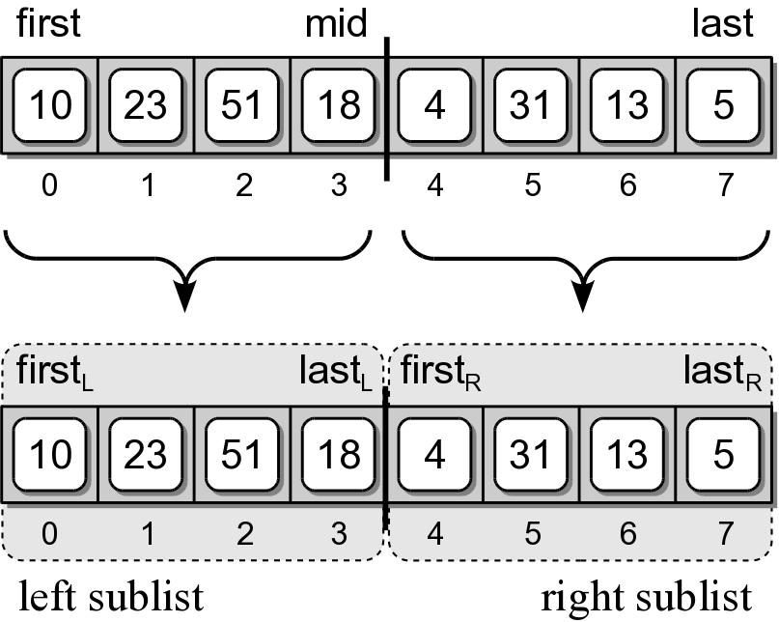
Merge Sort – Improved Version
We can improve the implementation:
using virtual subsequences.
that works with any sequence.

Slide 12
Merge Sort Code #2
An improved version of the merge sort.
def recMergeSort( theSeq, first, last, tmpArray ):
# Check the base case.
if first == last :
return
else :
# Compute the mid point.
mid = (first + last) // 2
# Split the sequence and perform the recursive step.
recMergeSort( theSeq, first, mid, tmpArray )
recMergeSort( theSeq, mid+1, last, tmpArray )
# Merge the two ordered subsequences.
mergeSeq( theSeq, first, mid+1, last, tmpArray )

Slide 13
Merging Sorted Sequences
def mergeSeq( theSeq, left, right, end, tmpArray ):
a = left
b = right
m = 0
while a < right and b <= end :
if theSeq[a] < theSeq[b] :
tmpArray[m] = theSeq[a]
a += 1
else :
tmpArray[m] = theSeq[b]
b += 1
m += 1
:
:

Slide 14
Merging Sorted Sequences
:
:
while a < right : # in parallel with first while
tmpArray[m] = theSeq[a]
a += 1
m += 1
while b <= end : # in parallel with the two whiles
tmpArray[m] = theSeq[b]
b += 1
m += 1
for i in range( end – left + 1 ) :
theSeq[i+left] = tmpArray[i]

Slide 15
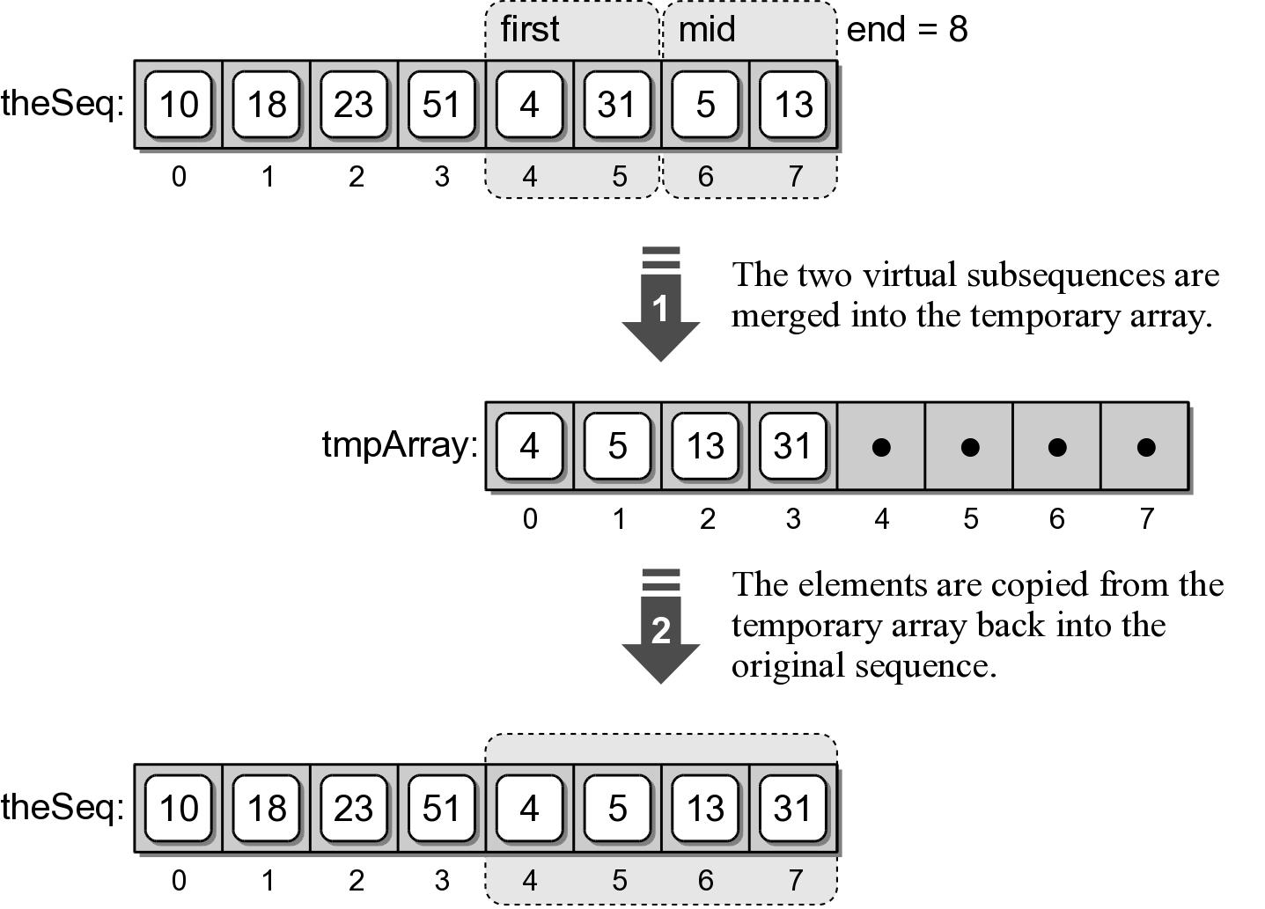
Merge Sort – Temporary Array
A temporary array is used to merge two virtual subsequences.

Slide 16
Wrapper Functions
A function that provides a simpler and cleaner interface for another function.
Provides little or no additional functionality.
Commonly used with recursive functions that require additional arguments.
def mergeSort( theSeq ):
n = len( theSeq )
tmpArray = Array( n )
recMergeSort( theSeq, 0, n-1, tmpArray )

Slide 17
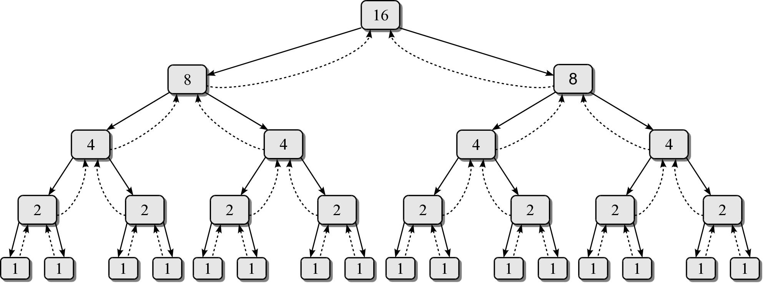
Merge Sort – Efficiency
We need to determine the number of invocations and the time required by each function.

Slide 18
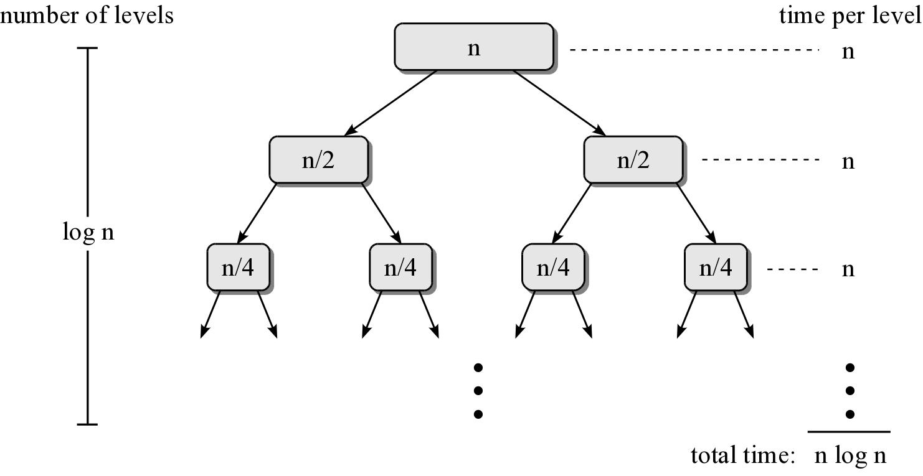
Merge Sort – Efficiency
Consider a sequence of n items.

Slide 19
Quick Sort
Uses a divide and conquer strategy to sort the keys stored in a sequence.
Partitions the sequence by dividing it into two segments based on a pivot key.
Uses virtual subsequences without the need for temporary storage.
Quick sort is a recursive algorithm.

Slide 20
Quick Sort – Description
Select the first key as the pivot (p)
Partition the sequence into segments L and G.
L contains all keys less than p
G contains all keys greater than or equal to p.
Recursively apply the same operation on L & G.
Continues until the sequence contains 0 or 1 key.
Merge the pivot and two segments back together.

Slide 21
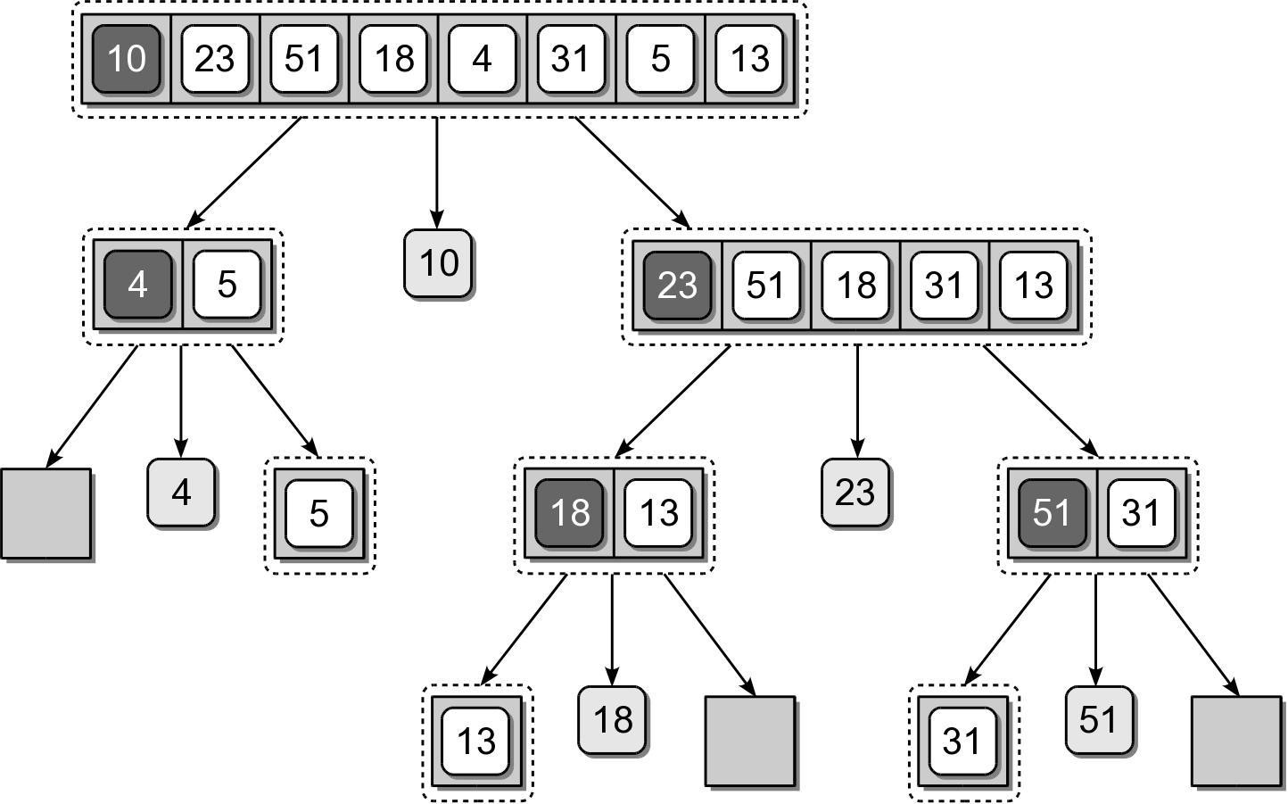
Quick Sort – Divide

Slide 22
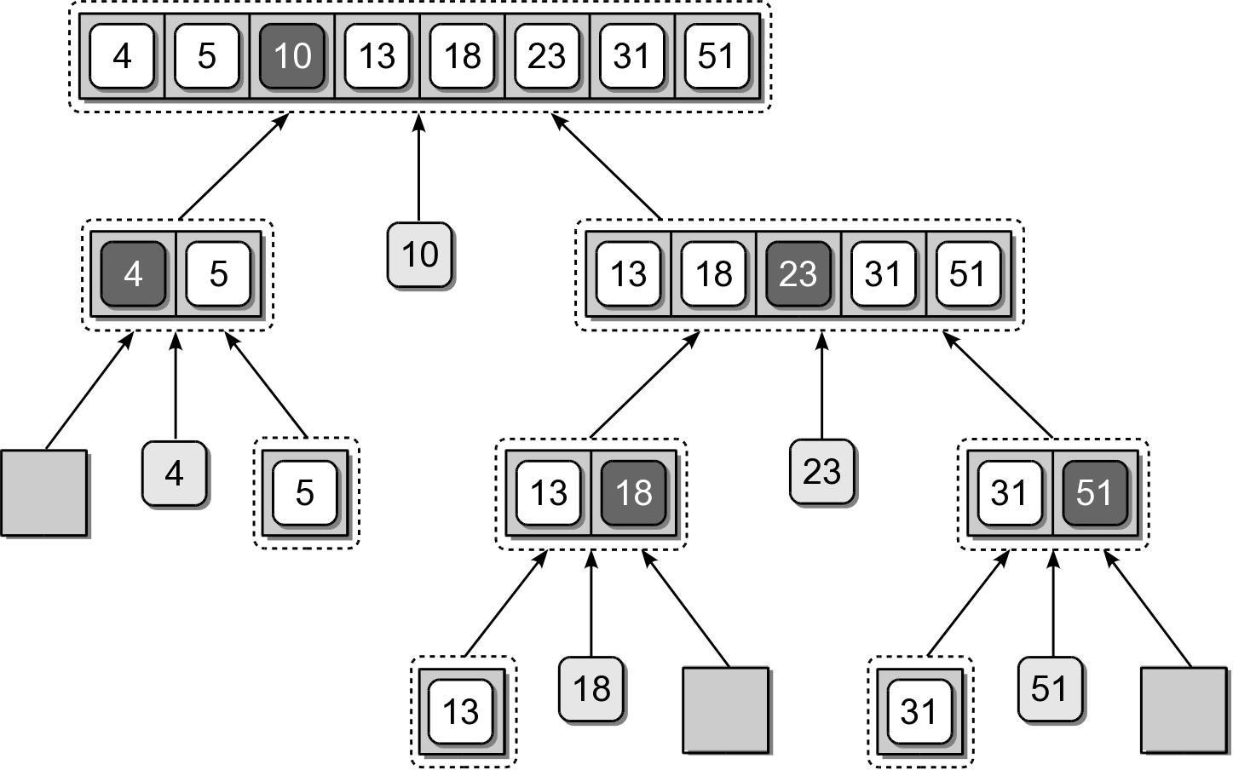
Quick Sort – Merge

Slide 23
Quick Sort – Implementation
An efficient solution can be designed.
def quickSort( theSeq ): n = len( theSeq )
recQuickSort( theSeq, 0, n-1 )
def recQuickSort( theSeq, first, last ):
if first >= last :
return else :
# Partition the sequence and obtain the
pivot
position.
pos = partitionSeq( theSeq, first, last )
# Repeat the | process | on the two subsequences.
recQuickSort( | theSeq, | first, pos - 1 )
recQuickSort( | theSeq, | pos + 1, last )

Slide 24
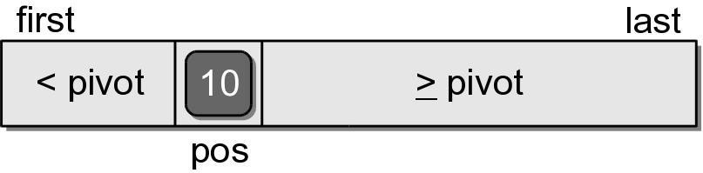
Quick Sort – Partition
The partitioning step can be done without having to use temporary storage.
Rearranges the keys within the sequence structure.
The pivot will be in its correct position within the sequence.
Position of the pivot indicates the position where the split occurred.

Slide 25
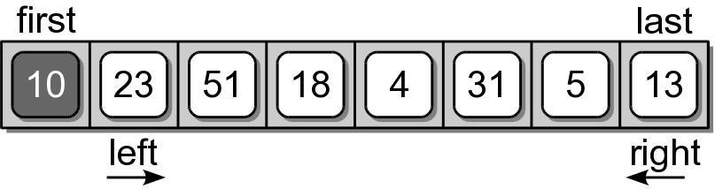
Quick Sort – Partition
For illustration, we step through the first complete partitioning.
Pivot value is the first key in the segment.
Two markers (left and right) are initialized.
The markers will be shifted left and right until they cross each other.

Slide 26
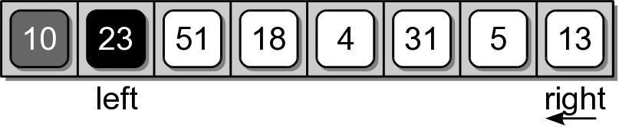
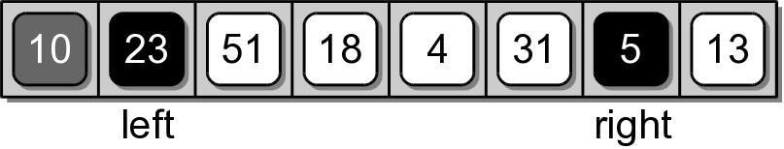
Quick Sort – Partition
The left marker is shifted right until a key value larger than the pivot is found.
The right marker is then shifted left until a key value less than the pivot is found.

Slide 27
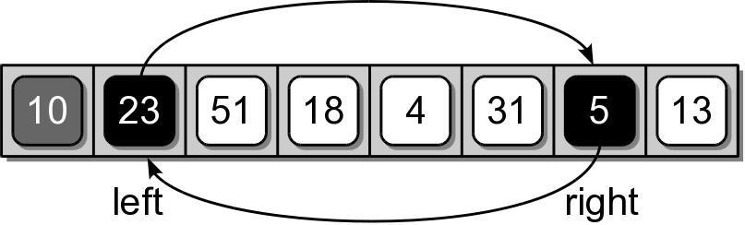
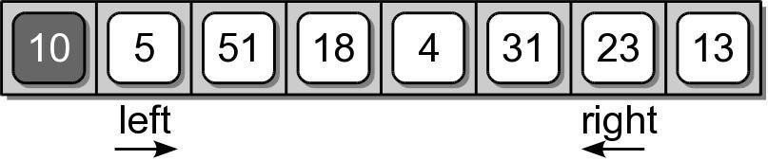
Quick Sort – Partition
The two keys at the positions of the left and
right markers are swapped.
10

Slide 28
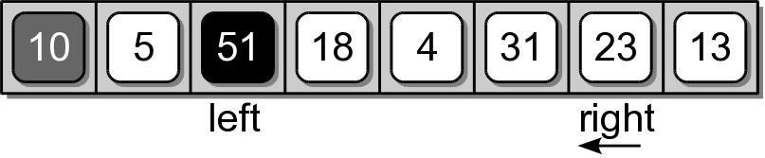
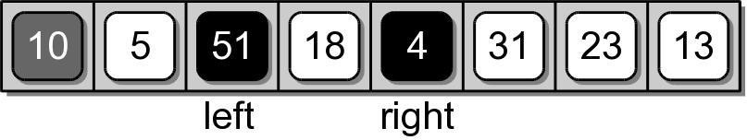
Quick Sort – Partition
The two markers are again shifted starting where they left off.

Slide 29
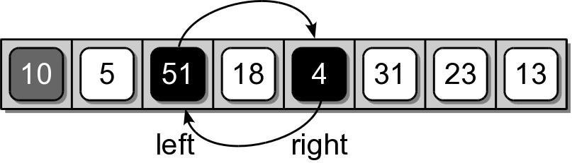
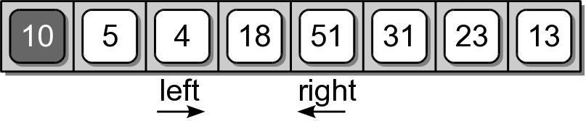
Quick Sort – Partition
After the markers are shifted, the corresponding keys are swapped as before.

Slide 30
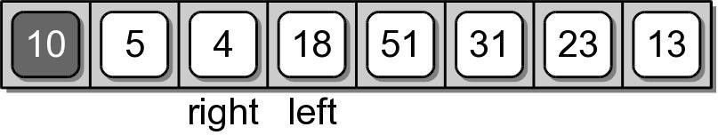
Quick Sort – Partition
The shifting and swapping continues until the two markers cross each other.

Slide 31
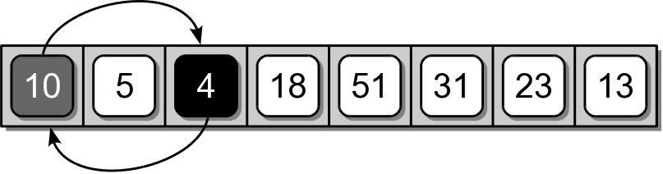
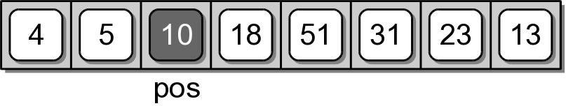
Quick Sort – Partition
When the two markers cross, the right marker indicates the final position of the pivot value.
The pivot value and the value at the right marker have to be swapped.

Slide 32
Quick Sort – Partition
def partitionSeq( theSeq, first, last ):
pivot = theSeq[first] left = first + 1 right = last
while left <= right :
while left < right and theSeq[left] < left += 1
pivot :
while right >= left and theSeq[right] right -= 1
>= pivot :
if left
tmp =
< right :
theSeq[left]
theSeq[left] = theSeq[right] theSeq[right] = tmp
if right != first theSeq[first] = theSeq[right] =
:
theSeq[right] pivot
return right

Slide 33
Pivot Key
We are not limited to selecting the first key within the sequence as the pivot.
Using the first or last key is a poor choice in practice.
Choosing a key near the middle is a better choice.

Slide 34
Quick Sort – Efficiency
The quick sort algorithm:
has a worst case time of O(n²)
but an average case time of O(n log n)
It does not require additional storage (in-place).
Commonly used in language libraries.
Earlier versions of Python used quick sort.
Current versions use a hybrid that combines the insertion and merge sort algorithms.

